Slide 1
Effects of a Multifaceted Intervention to Narrow the Evidence-Based Gap in the Treatment of Patients at High Cardiovascular Risk: The BRIDGE-Cardiovascular Prevention Cluster Randomized Trial
Embargoed until 5:30 p.m. CT/6:30 p.m. ET Saturday, Nov. 10, 2018
Otavio Berwanger (MD PhD) on Behalf of the Steering Committee
Sponsor: Amgen (Investigator-Initiated Trial)

Slide 2
Background and Rationale
Large-scale randomized trials have established the efficacy of antiplatelet therapy, statins and ACE inhibitors/ ARBs for the management of high CV risk patients.
The translation of research findings into practice is suboptimal and that these care gaps are even greater in low- and middle-income countries.
QI interventions have rarely been rigorously evaluated in low- and middle-income countries, where up to 80% of the global burden of CVD resides.

Slide 3
Study Flowchart
1619 high-risk, stable patients with established CV disease (prior CAD, prior stroke, or symptomatic PAD) from 40 Clusters (outpatient clinics from tertiary hospitals or primary care units)
Multifaceted QI
Intervention
18 clusters
(726 patients)
Routine Care
22 clusters
(893 patients)
CLUSTER
RANDOMIZED
(Concealed)
Visits: Screening, Randomization,
1, 6, and 12 months
Primary Endpoint: Adherence to antiplatelet therapy*, statins (any dose) and ACE inhibitors or ARBs at 12 months (all-or-none approach)
* DAPT if during the first 12 months post-ACS or post PCI with DES; single antiplatelet therapy for other patients

Slide 4
Trial Oversight
Steering/Writing Committee
Otavio Berwanger (Co-Chair)
M Julia Carrion (Co-Chair)
Airton Stein
Francisco H Fonseca
Maria C Izar
Celso Amodeo
Leopoldo Piegas
Renato D Lopes
Nilton Brandão da Silva
Octavio M. Pontes-Neto
J. Francisco K Saraiva
Eduardo Ramaciotti
Project Office (Research Institute HCor)
Lucas Damiani
Rafael M Soares
Bruna Sampaio
Nanci Valeis
Juliana Yamashita
Viviane Campos
Clinical Events Classification
Pedro Barros
Helio Penna Guimarães
Sponsor (Amgen)*
Daniel Martinez
Felipe Alves
Monica Mathias
Maristela Sampaio
* Investigator-Initiated Trial

Slide 5
Trial Design
Study Design: Pragmatic, Cluster Randomized Trial
Bias control: concealed allocation, blinded adjudication of endpoints, ITT analysis
Quality control: on-site monitoring + central statistical checking + e-CRF + central adjudication of eligibility criteria and endpoints
Sample Size: 1,619* patients from 40 clusters in Brazil. Original sample size: 1600 patients/42 clusters – 90% power to detect a 20% absolute improvement, considering a baseline rate of 50% for the primary endpoint, ICC= 0.20, a two-tailed alpha of 5%.
Statistical Analysis: Linear mixed effect logistic regression model- adjusted for baseline performance

Slide 6
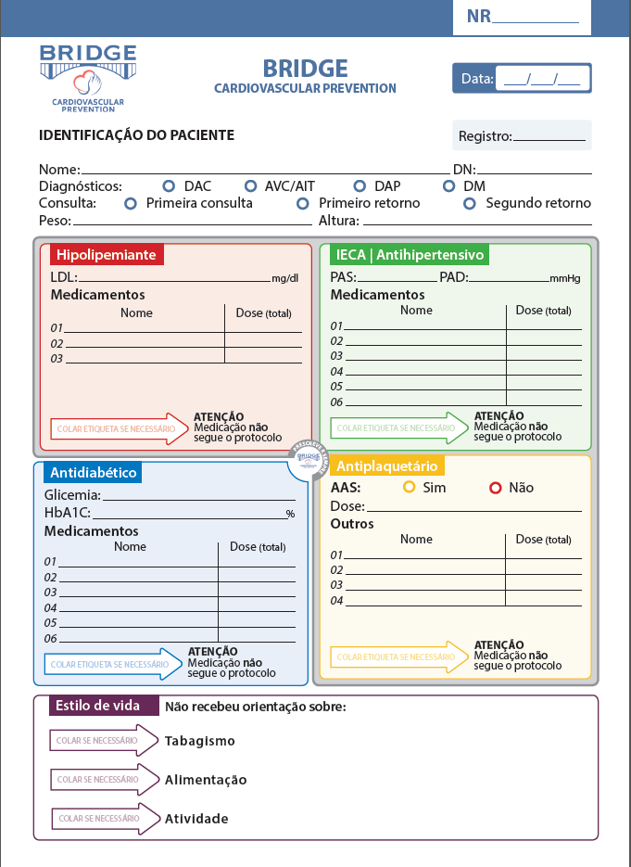
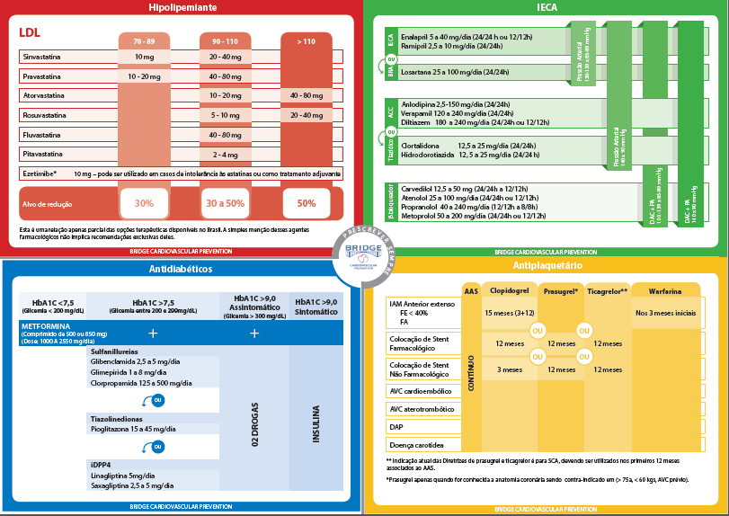
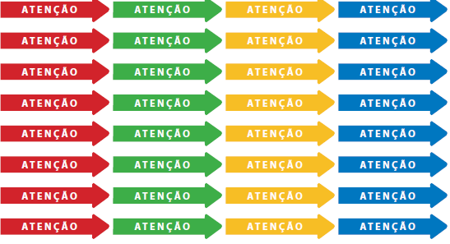
Intervention I
STEP 2
Reminders/Physician Propmting
(Pre-Physician Visit).
STEP 3
Physician Visit
With Decision Support Tool
(Summary Guidelines).
STEP 1
Case Manager Evaluation
(Pre-Physician Visit).

Slide 7
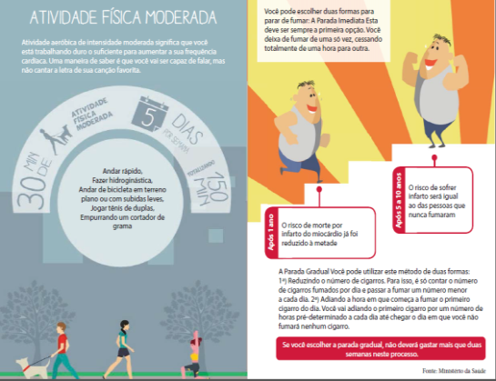
Intervention II
Patient Education
(Lifestyle modification).
Audit and Feedback Reports
(Monthly)

Slide 8
Secondary Endpoints at 12 months
Individual components of the primary endpoint.
Percentage of eligible patients with LDL below 70mg/dL and below 50mg/dL.
Adherence to high dose statins in patients without contra-indications.
Adherence to beta-blockers (post-MI patients)
Combined endpoint of cardiovascular mortality, nonfatal MI, or nonfatal stroke (Adjudicated).
Risk Factor control (HTN, DM, smoking cessation)

Slide 9
Patient Baseline Characteristics
Characteristics | Intervention | Control
 | (n=726) | (n=893)
Sex, male | 462 (63.6) | 567 (63.5)
Age, mean (SD) | 65.9 (10.4) | 65.4 (10.7)
Previous CAD | 612 (84.3) | 715 (80.1)
Previous MI | 370 (51) | 473 (53)
Previous stroke or TIA | 146 (20.1) | 209 (23.4)
Peripheral arterial disease | 83 (11.4) | 114 (12.8)
Hypertension | 662 (91.2) | 769 (86.1)
Diabetes | 308 (42.4) | 316 (35.4)
Dyslipidemia | 535 (73.7) | 563 (63)
Family history of CAD | 272 (37.5) | 333 (37.3)
Heart failure | 110 (15.2) | 161 (18)
Renal insufficiency | 26 (3.6) | 24 (2.7)
BMI > 30 | 231/725 (31.9) | 274/892 (30.7)
Current smoker | 74 (10.2) | 108 (12.1)

Slide 10
Cluster Baseline Characteristics
Characteristic | Intervention | Control
 | (n=18) | (n=22)
Specialty
Cardiology | 14 (77.8) | 16 (72.7)
Neurology | 0 (0) | 1 (4.5)
Vascular surgery | 1 (5.6) | 1 (4.5)
Internal medicine | 1 (5.6) | 0 (0)
Primary care unit | 2 (11.1) | 4 (18.2)
Teaching unit | 13 (72.2) | 13 (59.1)
Patient volume per month, median [IQR] | 285 [150 - 550] | 200 [100 - 489]
Public units | 9 (50.0) | 11 (50.0)
Structured protocol for care and management of patients at high cardiovascular risk. | 7 (38.9) | 11 (50.0)
* Baseline performance – primary endpoint: 52.3%

Slide 11
Primary Endpoint
Complete adherence to statins, antiplatelet therapy* and ACEi or ARB at 12 months after the intervention
100
90
80
%
70
60
73.5%
50
58.7%
40
30
20
10
0
Control
* DAPT if during the first 12 months post-ACS or post PCI with DES

Slide 12
Primary Endpoint
Complete adherence to statins, antiplatelet therapy* and ACEi or ARB at 12 months after the intervention
100
90
OR_{PA} = 2.30 [1.14 to 4.64], p=0.01
80
%
70
60
73.5%
50
58.7%
40
30
20
10
0
Intervention
Control
* DAPT if during the first 12 months post-ACS or post PCI with DES

Slide 13
Secondary Endpoints
OR_{PA} = 4.04 [1.50 to 10.89]
P<0.01
OR_{PA} = 3.13 [1.29 to 7.60]
P<0.01
100
OR_{PA} = 1.44 [0.88 to 2.36]
P=0.09
90
93.6%
94.0%
80
86.3%
81.7%
80.3%
70
74.4%
60
%
50
40
30
20
10
0
Intervention
Control
Intervention
Control
Intervention
Control
Statins
Antiplatelet Therapy *
ACEi or ARB
* DAPT if during the first 12 months post-ACS or post PCI with DES

Slide 14
ENDPOINT | INTERVENTION | CONTROL | OR_{PA} 95%CI | P
High-dose statins | 74/701 (10.6) | 59/840 (7.0) | 2.64 (0.80 to 8.72) | .06
Beta blockers post-MI | 281/358 (78.5) | 332/456 (72.8) | 1.37 (0.58 to 3.22) | .40
Smoking cessation | 364/701 (51.9) | 153/840 (18.2) | 11.24 (2.20 to 57.43) | <.01
LDL < 70mg/dL | 177/432 (41.0) | 146/380 (38.4) | 1.12 (0.60 to 2.09) | .67
BP < 140/90 mmHg (HTN) | 433/638 (67.9) | 432/722 (59.8) | 1.37 (0.87 to 2.18) | .11
SBP < 120 mmHg | 158/638 (24.8) | 166/722 (23) | 1.00 (0.51 to 1.94) | 0.99
HbA1c ≤ 7.0% (DM) | 83/165 (50.3) | 67/139 (48.2) | 1.37 (0.52 to 3.60) | .44

Slide 15
ENDPOINT | INTERVENTION | CONTROL | OR_{PA} 95%CI | P
High-dose statins | 74/701 (10.6) | 59/840 (7.0) | 2.64 (0.80 to 8.72) | .06
Beta blockers post-MI | 281/358 (78.5) | 332/456 (72.8) | 1.37 (0.58 to 3.22) | .40
Smoking cessation | 364/701 (51.9) | 153/840 (18.2) | 11.24 (2.20 to 57.43) | <.01
LDL < 70mg/dL | 177/432 (41.0) | 146/380 (38.4) | 1.12 (0.60 to 2.09) | .67
BP < 140/90 mmHg (HTN) | 433/638 (67.9) | 432/722 (59.8) | 1.37 (0.87 to 2.18) | .11
SBP < 120 mmHg | 158/638 (24.8) | 166/722 (23) | 1.00 (0.51 to 1.94) | 0.99
HbA1c ≤ 7.0% (DM) | 83/165 (50.3) | 67/139 (48.2) | 1.37 (0.52 to 3.60) | .44

Slide 16
Clinical Events - MACE
Major Cardiovascular Events (MACE)*
10.0
HR: 0.76 (0.43 to 1.34); P= 0.34
7.5
%
5.0
Control
2.5
Intervention
0
0
30
60
90
120
150
180
210
240
270
300
330
360
Patients at risk
Time (days)
Control
885
856
854
854
852
848
842
840
836
828
813
786
658
Intervention
725
720
718
716
714
714
708
706
704
701
690
647
504
*Combined occurrence of a first cardiovascular event (cardiovascular mortality, non-fatal acute myocardial infarction, or non-fatal stroke).

Slide 17
Subgroup Analysis
Subgroup | Complete adherence to statins, antiplatelets and ACEi or ARB |  | Odds Ratio (95% CI) |  | P value for interaction*
 | Intervention | Control
 | n/N (%)
Unit profile
Hospital outpatient clinic | 479/658 (72.8) | 424/702 (60.4) |  | 1.93 [0.95 - 3.93] | 0.10
Primary care center | 36/43 (83.7) | 69/138 (50.0) |  | 9.51 [1.18 - 76.38]
Unit status
Non-teaching unit | 115/184 (62.5) | 228/375 (60.8) |  | 0.91 [0.30 - 2.71] | 0.02
Teaching unit versus | 400/517 (77.4) | 265/465 (57.0) |  | 3.68 [1.66 - 8.18]
Patient admission
Specialized unit | 440/608 (72.4) | 422/693 (60.9) |  | 1.75 [0.85 - 3.59] | 0.06
General unit | 75/93 (80.6) | 71/147 (48.3) |  | 7.87 [1.56 - 39.55]
Polyvascular diisease
No | 296/412 (71.8) | 191/349 (54.7) |  | 2.79 [1.10 - 7.04] | 0.52
Yes | 219/289 (75.8) | 302/491 (61.5) |  | 1.89 [0.71 - 5.07]
...
...
Favors Control
Favors Intervention
0.2
0.33
0.5
1.0
2.0
3.0
5.0
10.0
20.0
30.0

Slide 18
Conclusions
In conclusion, in patients at high cardiovascular risk, a multifaceted QI intervention resulted in significant improvement in the use of evidence-based therapies.
The tools tested in our trial can become the basis for developing QI programs to maximize the use of evidence-based interventions for the management of patients with established cardiovascular disease, especially in limited resource settings.

